Slide 1
Meadowlands Natural Gas Power Plant Proposal
Jeff Tittel, Director of the New Jersey Sierra Club

Slide 2
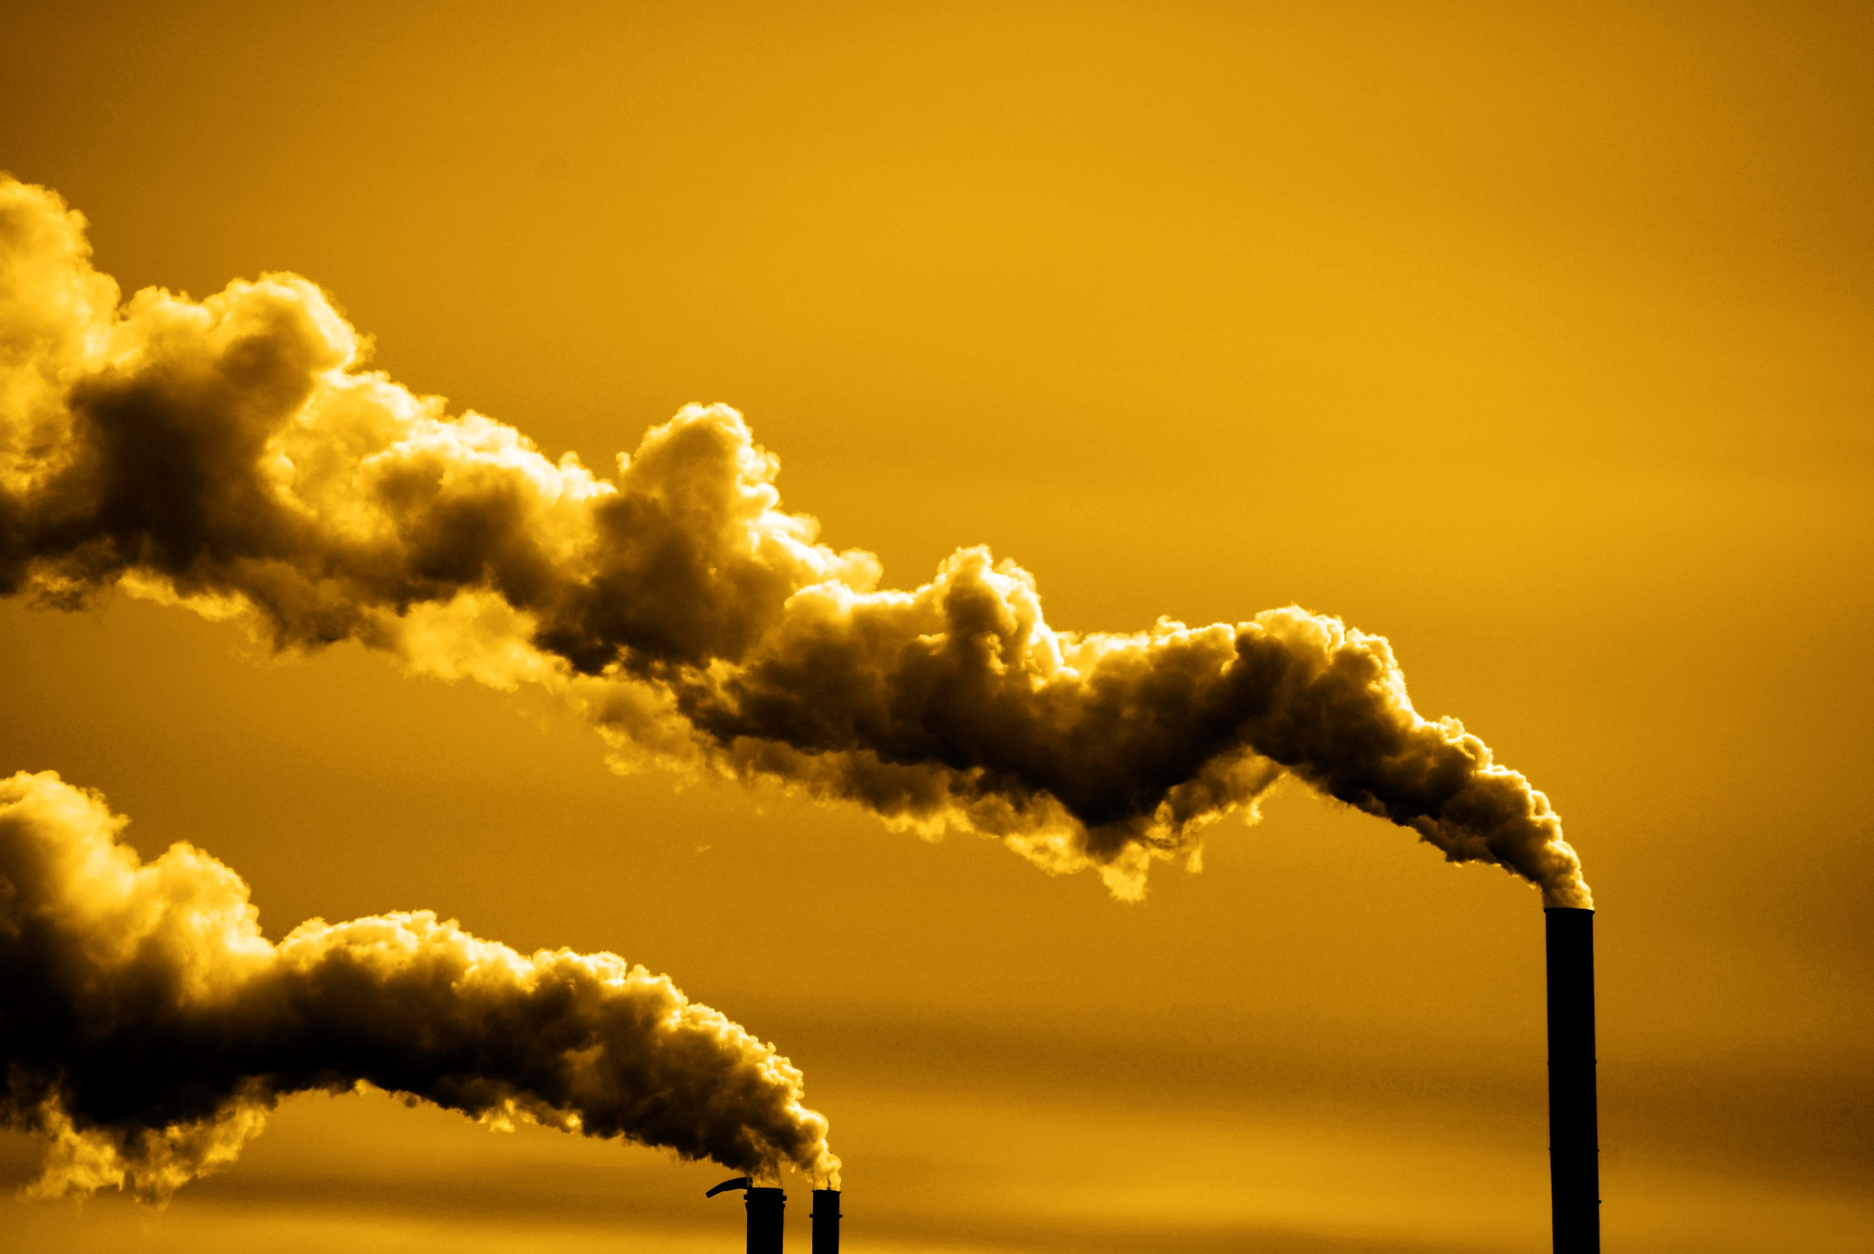
Air Pollution from Power Plant
This plant could generate almost 2.4 million metric tons of carbon dioxide a year
It could be very close to being the one top greenhouse gas producer in North Jersey
These types of plants are monsters of air pollution in New Jersey emitting heavy metals and chemicals like ammonia and nitrogen oxide.
They would need to upgrade a pipeline into the proposed natural gas powerplant
More natural gas means more pipelines like the TRANSCO Rivervale Pipeline
The Rivervale South to Market project would be a direct threat to the Oradell and Lake Tappan Reservoirs.
More pipelines means more fracking- this means more GHGs emitted and toxic frack wastewater discharge containing over 700 chemicals.
Air pollution from power plant can make their way into our water sources primarily through atmospheric deposition

Slide 3
Natural Gas Power Plants in New Jersey (In Operation, Approved, Proposed)
PSEG’s Bergen Generating Station: 2.6 million
Phillips 66 Bayway Refinery: 2.5 million
Quixx Power Services Inc: 2.3 million
Meadowlands Natural Gas Power Station: 2.3 million*
Linden Generating Station: 2.28 million
Musconetcong Power Plant: 1.4 million*
Keasbey- Woodbridge Power Plant: 1.3 million*
Sewaren 7 Power Plant: 1.1 million**
BL England Power Plant: 900,000**
*Proposed
**Approved
New Jersey GHG Emission have increased in recent years by 3-5%
source: https://www.mycentraljersey.com/story/news/local/land-environment/2016/10/11/study-finds-100-super-polluters-fouling-air-we-breathe/91908548/
Source: http://www.nj.gov/dep/dsr/trends/pdfs/ghg.pdf

Slide 4
DEP Has the Authority to Block Natural Gas Power Plants
Since 2005, DEP has the authority to regulate greenhouse gases and carbon well and deny air permitting and Title V permits
The Department determines, based on the evidence outlined herein, that regulating carbon dioxide (CO2) as an air contaminant is in the best interest of human health, welfare, and the environment. This statement shall fulfill the Department’s requirement to advise the public of its determination and justification for this determination, pursuant to N.J.S.A. 26:2C-9.2i.
The Department’s determination is based on compelling scientific evidence of existing and projected adverse impacts due to climate change on the environment, ecosystems, wildlife, human health, and enjoyment of property in the State. The Department also bases this determination in part on the expected impacts of climate change on the formation of ground-level ozone. Increases in average temperature and related extreme heat events will increase the formation of ground-level ozone and further undermine the State’s attempts to meet national ambient air quality standards (NAAQS) for NOx, with attendant increases in adverse human health and environmental impacts, as well as State compliance costs.
DEP Regulations in air monitoring
Guidance on preparing an air quality modeling protocol
Guidance on preparing a risk assessment for air contaminant emissions
Guidelines for evaluating proposed emission rates
Inclusion of Hazardous Air Pollutants (HAP’s) in air permits
Modeling and permitting for PM 2.5 Sources
Procedures for conducting risk assessments to determine incremental health risks
Sources requiring an air quality impact analysis
State of the Art Applicability for Modified sources (BL England is modified source)
Risk assessment guidance

Slide 5
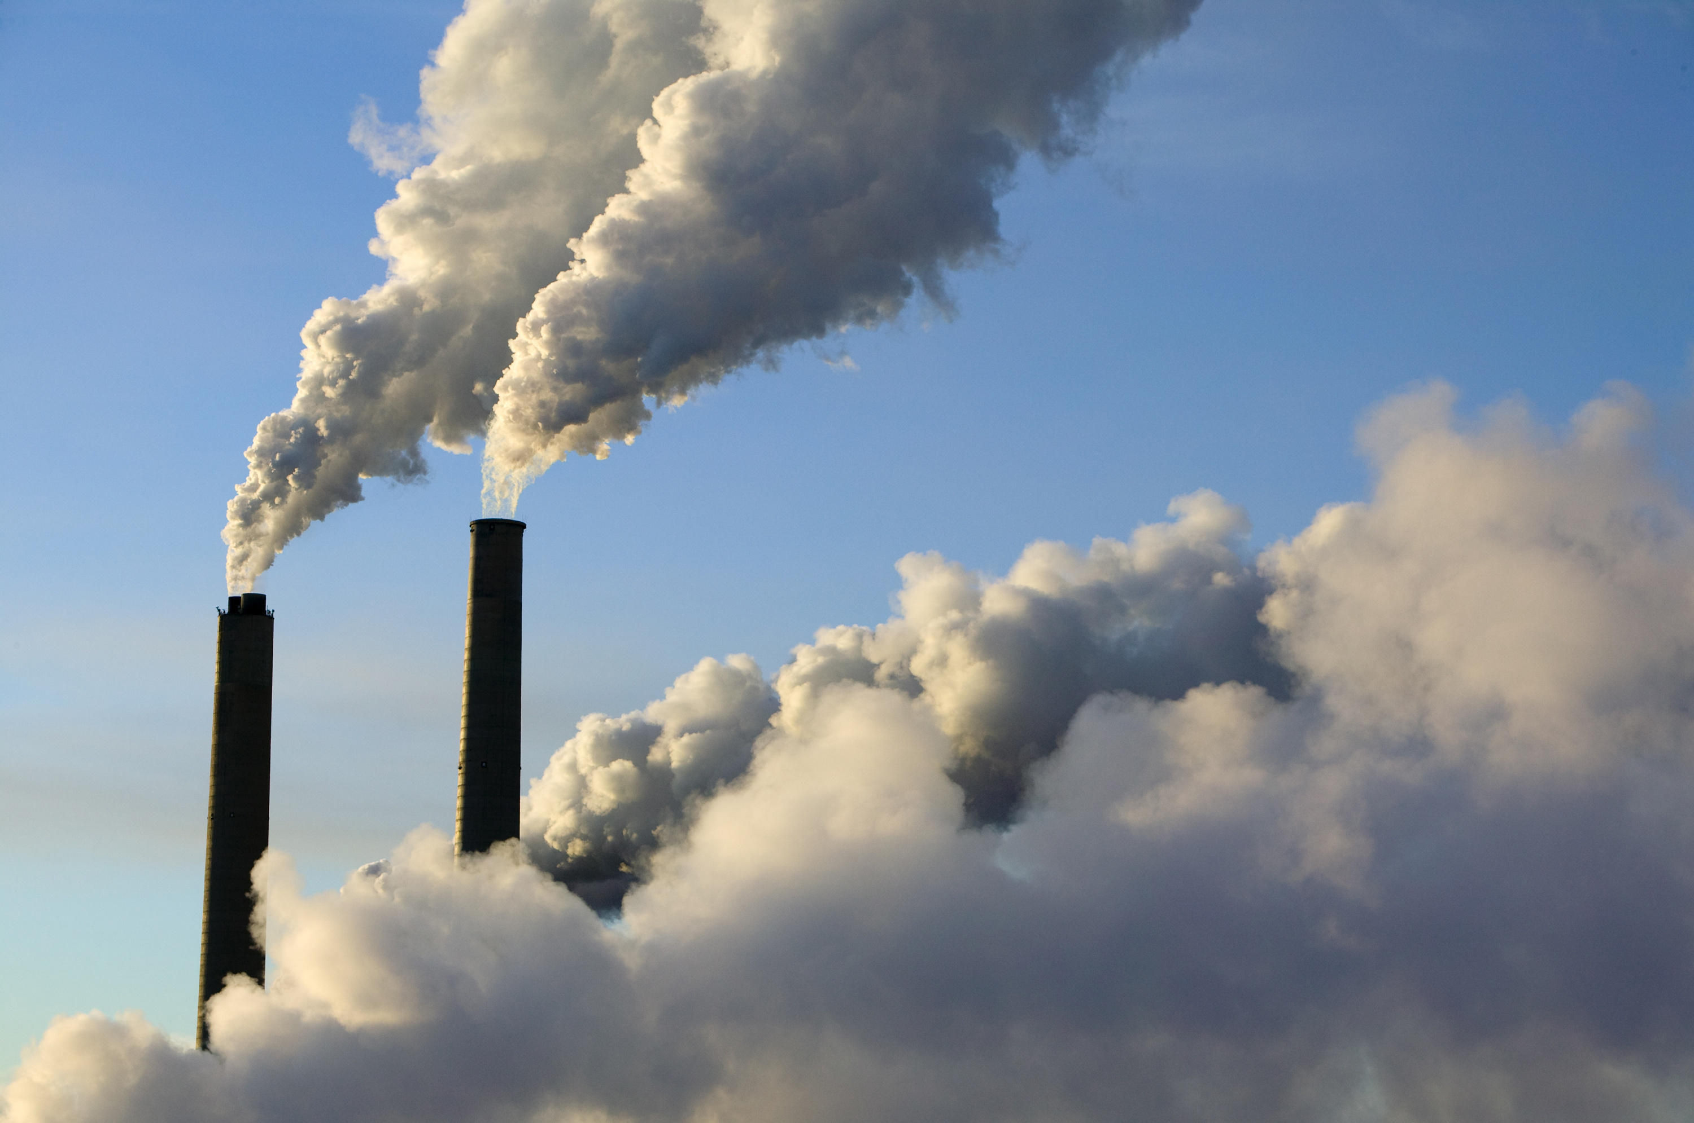
NY Rejects Title V Permit For Natural Gas Power Plant
NY DEC Rejects Wawayanda NG Power Plant: Aug. 2018- NY State officials denied Competitive Power Venture renewal of their Orange County natural gas power plant’s air permits
New Jersey Can Too
NJ has the authority to do to deny Title V permits for Natural Gas Power Plants
Other ways to reject Power Plant
BPU has the authority to regulate GHG’s and deny projects that increase GHG’s
Global Warming Response Act calls for a 80% reduction in greenhouse gases from baseline year 2006 by 2050. We also have to meet 2020 goals
Under RGGI, NJ is supposed to be reducing C02 emissions
RGGI calls for a Cap on 13 tons of C02- NJ is currently at 18 and these new natural gas powerplants will put us at 23 tons: Musconetcong Power Plant: 1.4 million, Keasbey- Woodbridge Power Plant: 1.3 million Sewaren 7 Power Plant: 1.1 million, BL England Power Plant: 900,000 metric tons of CO2

Slide 6
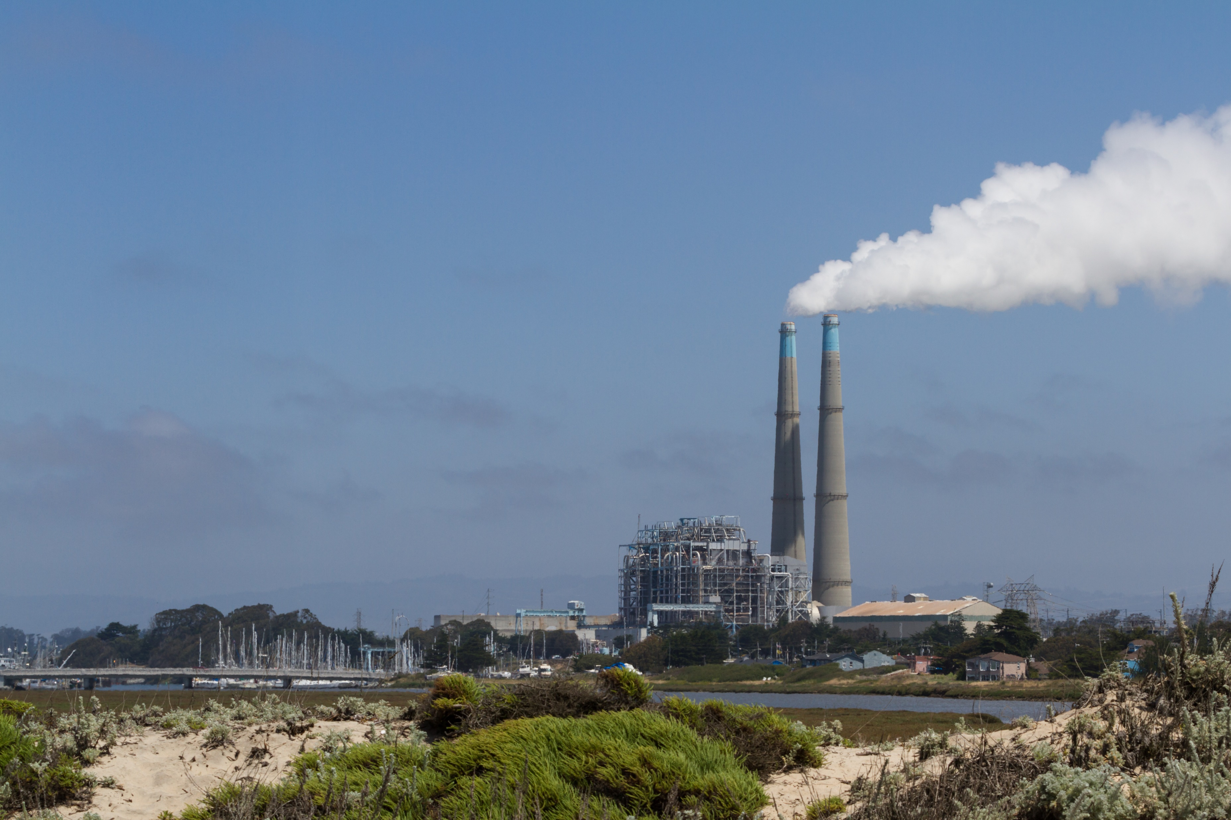
Chemical Drift/ Air Deposition
The power plant would use an estimated 8.6 million gallons of sewage discharge wastewater a day.
This means there will be even more chemicals that will be evaporated off as chemical drift.
Air pollution from power plant can make their way into our water sources primarily through atmospheric deposition
That steam can contain heavy metals like lead, algaecides, fungicides, and volatile organic compounds that will cool and end up on land, in our water, and killing plant life near the cooling towers
Pollution Nitrogen oxide puts nitrogen into our water ways and can contribute to harmful algal blooms- this sometimes create toxins that can kill fish and other animals.
Chemicals that come out of the smoke stack that can end up in our water include mercury and sulfur dioxide

Slide 7
Health Impacts Natural gas plants are not clean and only a bridge to more asthma and health problems.
This area is already overburdened with air pollution, building another massive gas power plant will only exacerbate that
We are out of compliance for air pollution, ozone, and ppm2.5
Bergen and Hudson county already have an F rating by the American Lung Association for ozone pollution.
Our ozone levels are so high that it may put sensitive individuals at risk, including such as children, the elderly and people suffering from asthma, heart disease and other lung ailments.
Ppm 2.5 comes from natural gas and causes lung irritation

Slide 8
DEP Gives Permits to Mega Powerplant – Sells out Meadowlands
The Department of Environmental Protection has granted the North Bergen Liberty Generating project for the following permits:
Waterfront Development
Flood Hazard
Wetlands
Water Quality Certificate
The permits authorize “the construction of a gas turbine combined cycle electric generation station with related amenities including two (2) stormwater outfall structures, and the installation of an underground cable line(s) from the generating station to and under the Hudson River.
What DEP did was shameful, they not only gave out permits, but they didn’t even look at the secondary cumulative impacts of this massive power plant
They did not account for the potential 2.5 million metric tons of carbon dioxide a year coming from the plant.

Slide 9
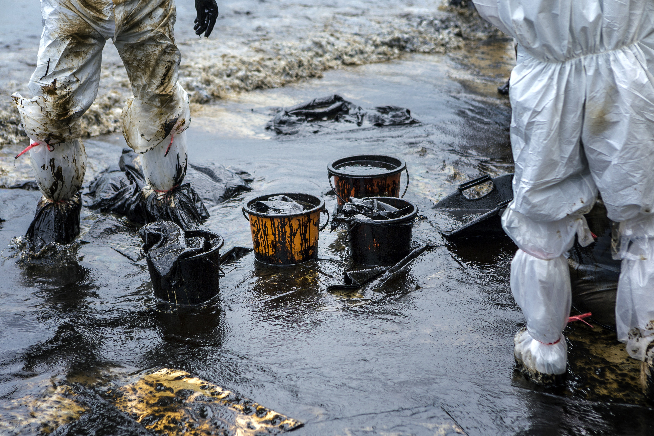
Chance of Oil Spills
On cold days and other times of the year there will be a shortage of natural gas, which means the power plant will have will have to store over a million gallons of oil upslope from the Meadowlands for backup.
There is a means there could be leaks and a chance of an oil spill.
This project must be examined in context with the other infrastructure it would connect to and lead to being built in New Jersey.
There would be more pipelines and compressor stations, including the proposed Gateway Project expansion and Roseland Compressor Station
There could be hundreds of trucks coming into site that will add to more pollution if this plant were to be built.
Much of this gas is more likely to go out of state or to export rather than service the people of New Jersey.

Slide 10
Economic Impacts on our Green Economy
This power plant would pay almost no property taxes
This power plant would pay about 10% for their property taxes because they are exempted under a NJ law that exempts energy utility facilities.
The Power plant proposal is a $1.5 billion plan- but it will be taxed under normal rate.
This means instead of getting $55 million a year from the plant, we will only be getting $5 million.

Slide 11
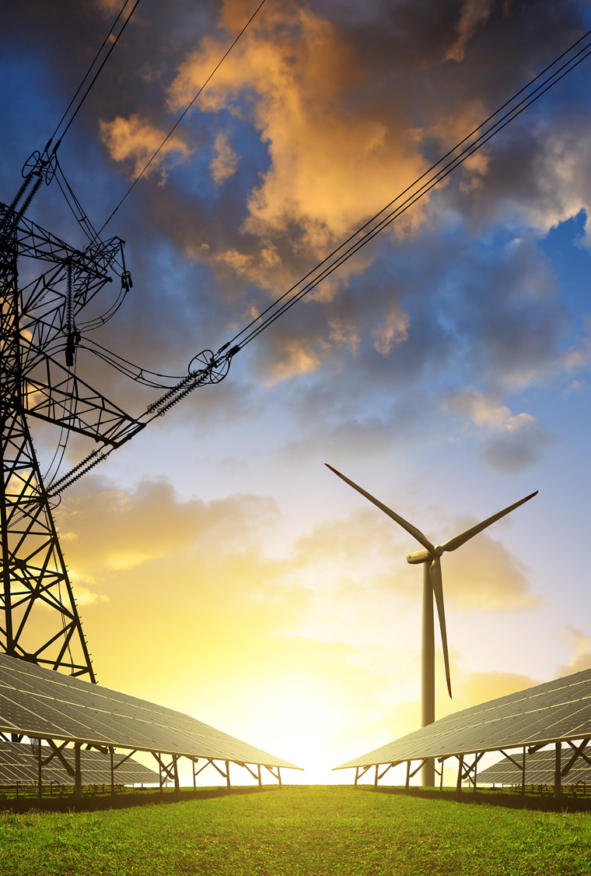
Benefits of Investing in Renewable Energy
We should not be building more natural gas infrastructure if we want to reach Governor Murphy’s strong environmental and clean energy goals for New Jersey.
We should be investing $1.5 billion in solar and wind farms
We could create 1,000s of more jobs building renewable energy projects like offshore windmills and solar farms.
If we want to get to 100% green energy by 2050 we need to focus on renewable energy

Slide 12
Why We Don’t Need Another Natural Gas Power Plant
Much of this gas is more likely to go out of state or to export rather than service the people of New Jersey.
While New Jersey gets the pollution, New York gets the electricity.
We’re already seeing setbacks with the current nuclear subsidy law and this power plant would be a one-two punch to clean energy and creating green jobs.
The Nuclear Subsidy Law just signed by Governor Murphy requires consumers to buy 40% or 480MW of electricity. If we expand more natural gas power plants, we will end up buying even more out-of-state nuclear power to make up for it.
The Sierra Club has asked Governor Murphy to sign an executive order on a moratorium on fossil fuel electrical generation plants until New Jersey reaches its renewable energy goals.

Slide 13
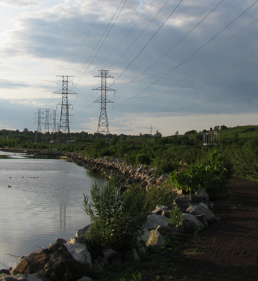
What You Can Do
Ask Governor Murphy to put a moratorium on new gas plants in New Jersey because we need to stop the proliferation of dirty fossil fuels across our state
Governor Cuomo committed to moratorium on gas fired power plants- Governor Murphy must too
Ridgefield & Union City Pass Resolution to Oppose Meadowlands Power Plant
We need more towns in Bergen and Hudson County to come out against this power plant

